Slide 1

Phylolinguistics part 1
Benedict King, MPI EVA

Slide 2
Learning Goals
Understand the motivation and philosophy behind Phylogenetics
What kind of data is required for input into a phylogenetic analysis of languages
Understand the major components of Bayesian phylogenetic methods
How to interpret the output of a phylogenetic analysis

Slide 3
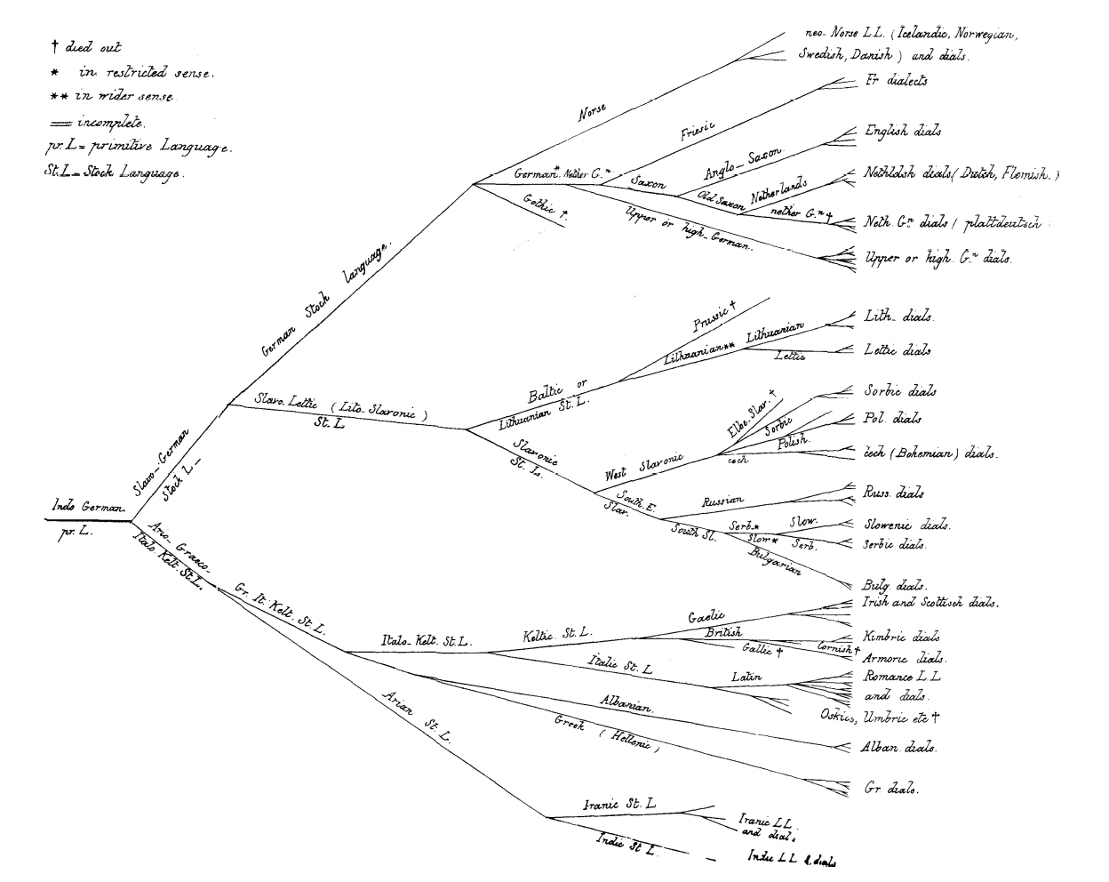
Why phylogenetics for linguistics?
Variation in traits
Inheritance of traits
Lineage splitting
Schleicher 1863

Slide 4
What is phylogenetics?
It does NOT involve overall similarity measures
Biology | Linguistics
Phenetics | Lexicostatistics

Slide 5
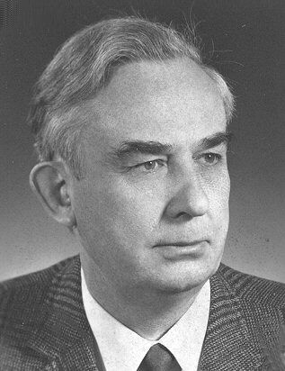
What is phylogenetics?
By making assumptions about the underlying PROCESS, we can reconstruct more informative relationship hypotheses
Lineages split
Innovations appear and are transmitted to descendants
Willi Hennig

Slide 6
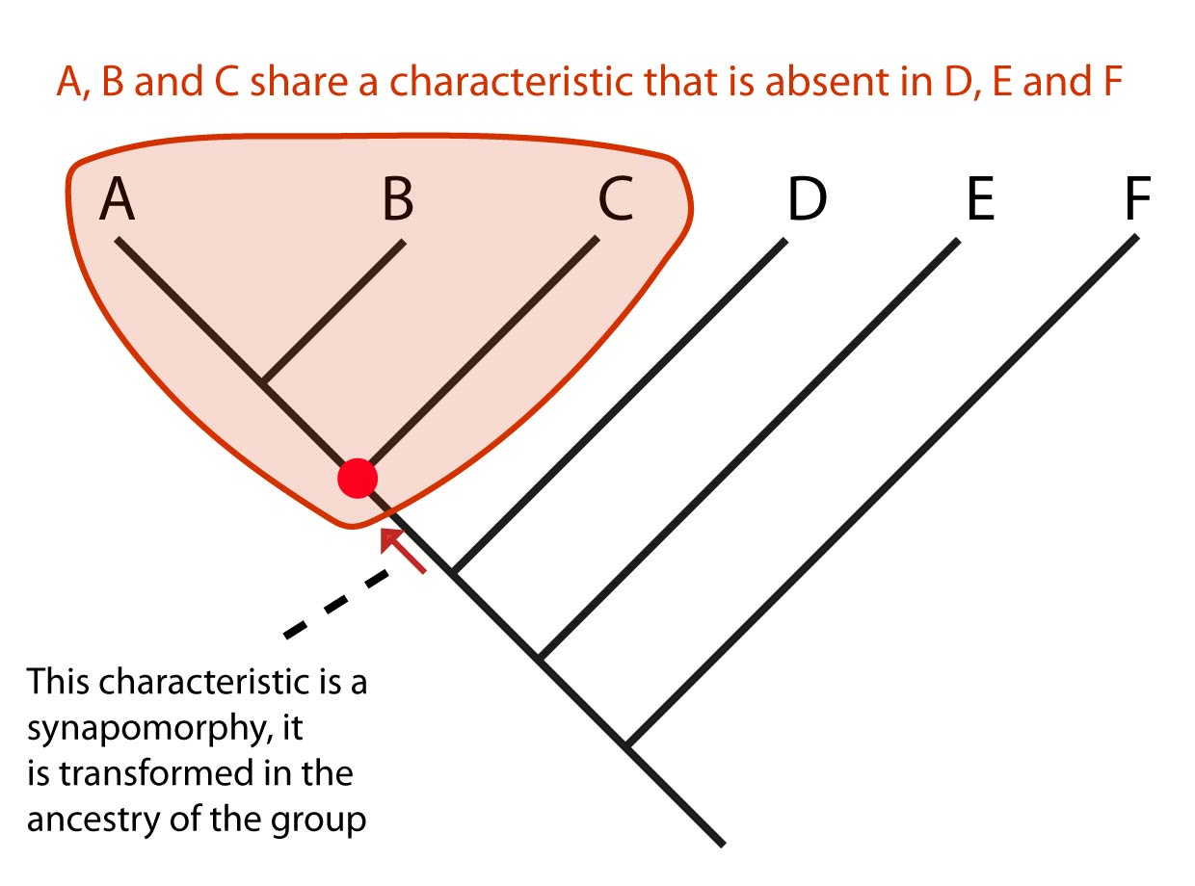
What is phylogenetics?
It is forming groups based only on INNOVATIONS
Biology | Linguistics
Cladistics, Phylogenetic systematics | Historical Linguistics, Linguistics Phylogenetics
Synapomorphy | Innovation
Symplesiomorphy | Retention

Slide 7
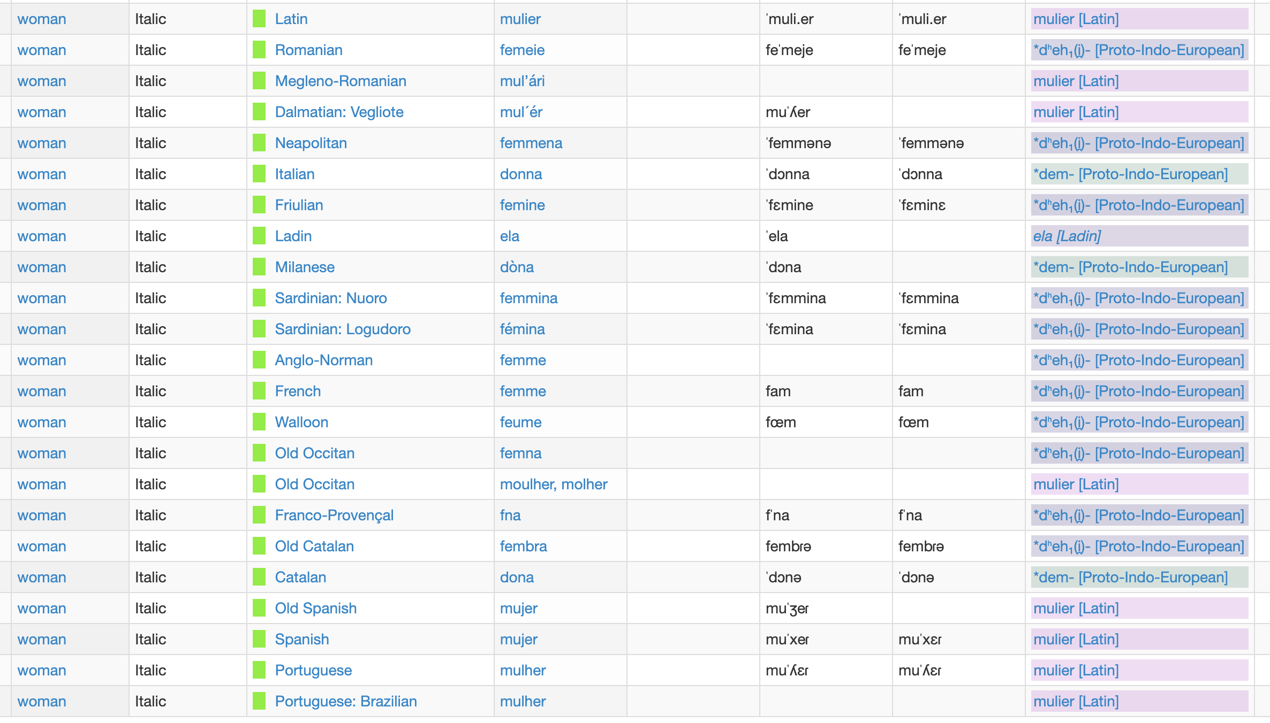
Data for linguistic phylogeny
1. Swadesh List of basic vocabulary concepts/meanings
3. Classify lexemes into cognate sets
2. Record lexeme for each language

Slide 8
Data is binarised for analysis
 | mulier [Latin] | *dem- [Proto-Indo-European] | *dʰeh₁(i̯)- [Proto-Indo-European] | ela [Ladin]
Portuguese: Brazilian | 1 | 0 | 0 | 0
Portuguese | 1 | 0 | 0 | 0
Spanish | 1 | 0 | 0 | 0
Old Spanish | 1 | 0 | 0 | 0
Catalan | 0 | 1 | 0 | 0
Old Catalan | 0 | 0 | 1 | 0
Franco-Provençal | 0 | 0 | 1 | 0
Old Occitan | 1 | 0 | 0 | 0
Old Occitan | 0 | 0 | 1 | 0
Walloon | 0 | 0 | 1 | 0
French | 0 | 0 | 1 | 0
Anglo-Norman | 0 | 0 | 1 | 0
Sardinian: Logudoro | 0 | 0 | 1 | 0
Sardinian: Nuoro | 0 | 0 | 1 | 0
Milanese | 0 | 1 | 0 | 0
Ladin | 0 | 0 | 0 | 1
Friulian | 0 | 0 | 1 | 0
Italian | 0 | 1 | 0 | 0
Neapolitan | 0 | 0 | 1 | 0
Dalmatian: Vegliote | 1 | 0 | 0 | 0
Megleno-Romanian | 1 | 0 | 0 | 0
Romanian | 0 | 0 | 1 | 0
Latin | 1 | 0 | 0 | 0

Slide 9
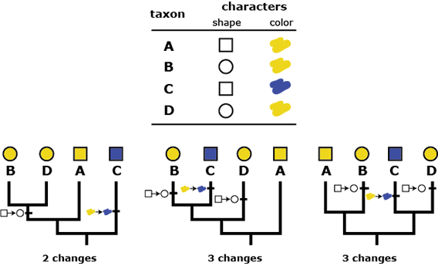



Parsimony
For a particular tree, the total number of steps required across all characters is known as the tree length
The tree with the shortest length is known as the most parsimonious tree
There may be more than one
tree length:
2 steps
tree length:
3 steps
tree length:
3 steps

Slide 10
Model-based Phylogenetics – why?
Rates of change across branches of the tree
Allow varying rates between different meanings
Estimate the age of divergences in the phylogeny
Estimate meaningful branch lengths – either in units of time or amount of linguistic change
Account for and quantify uncertainty

Slide 11
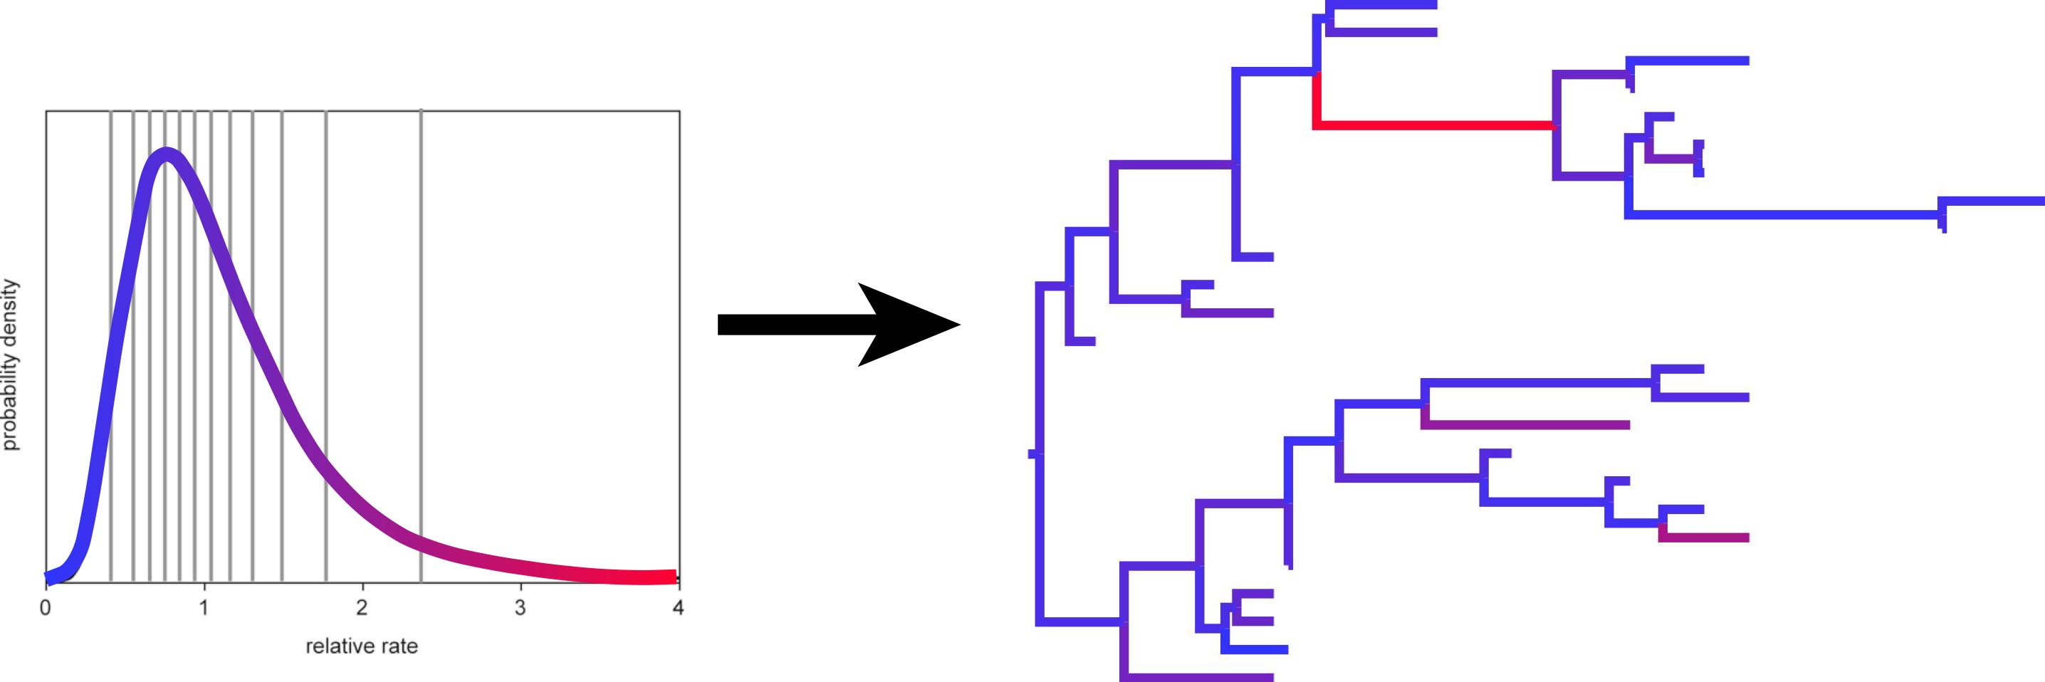
Overview of a generative phylogenetic model
Tree model
0
1
“Clock” model
(Branches have different rates)
Model of cognate gain and loss
Tree
+
+
Cognate data

Slide 12
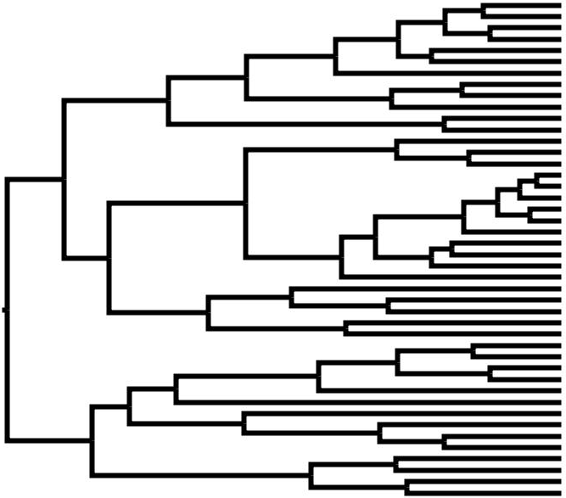
Tree model generates the branching process

Slide 13
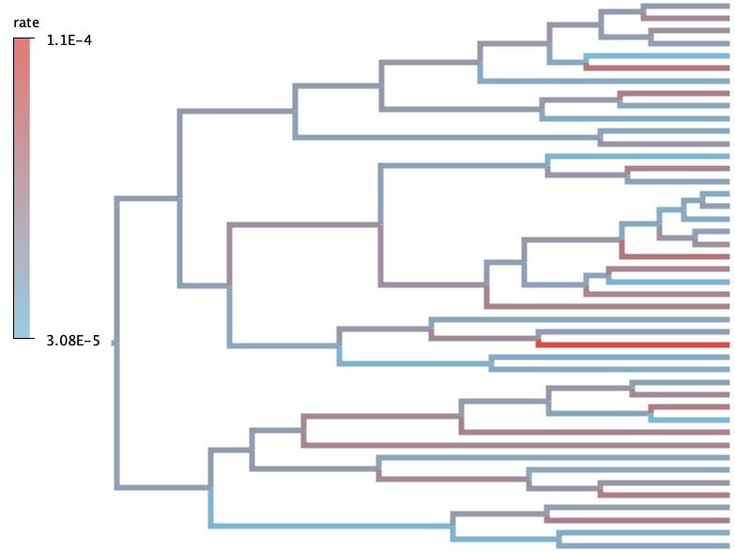
Rate model (“clock”) determines speed of change on branches

Slide 14
Substitution model describes how traits change along the tree

Slide 15
1. Tree models
Describe the branching of the tree
Birth rate – how often languages branch in two
Death rate – how often languages go extinct
Any variation in the birth rate and death rate
Sampling rate: how often through time languages are sampled, e.g. as written records

Slide 16
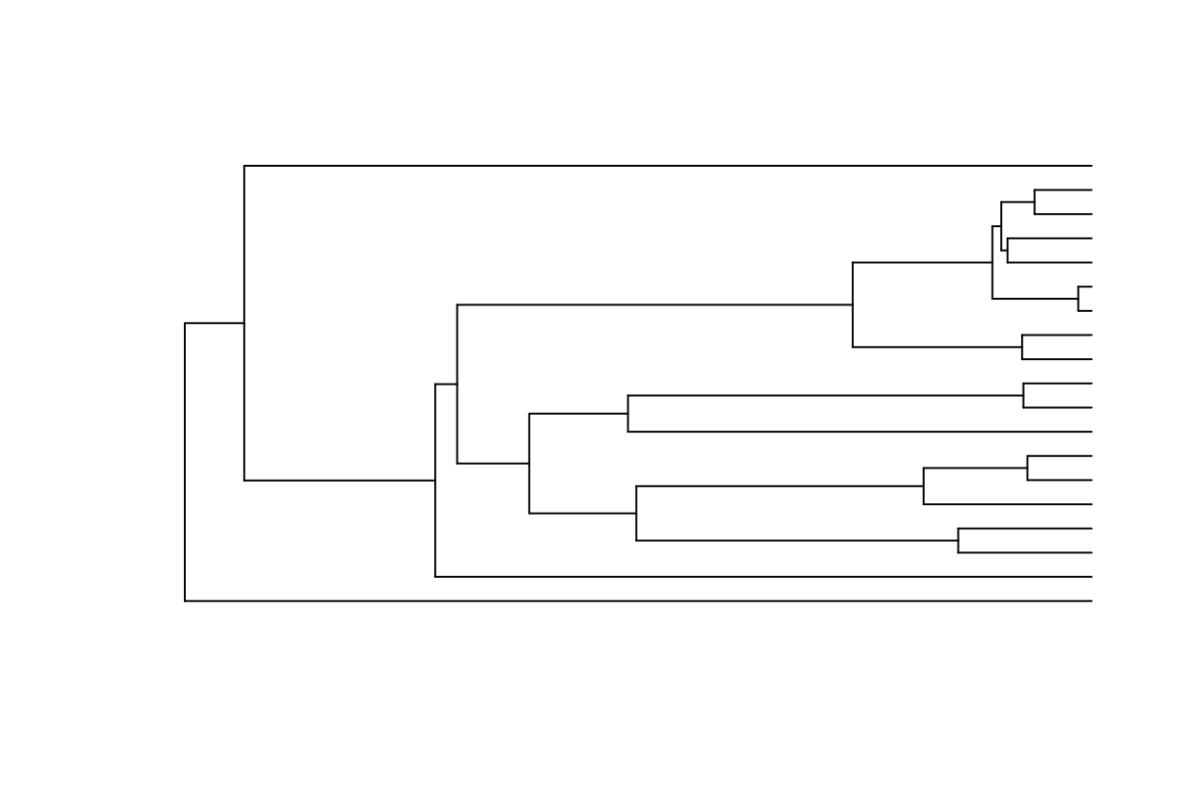
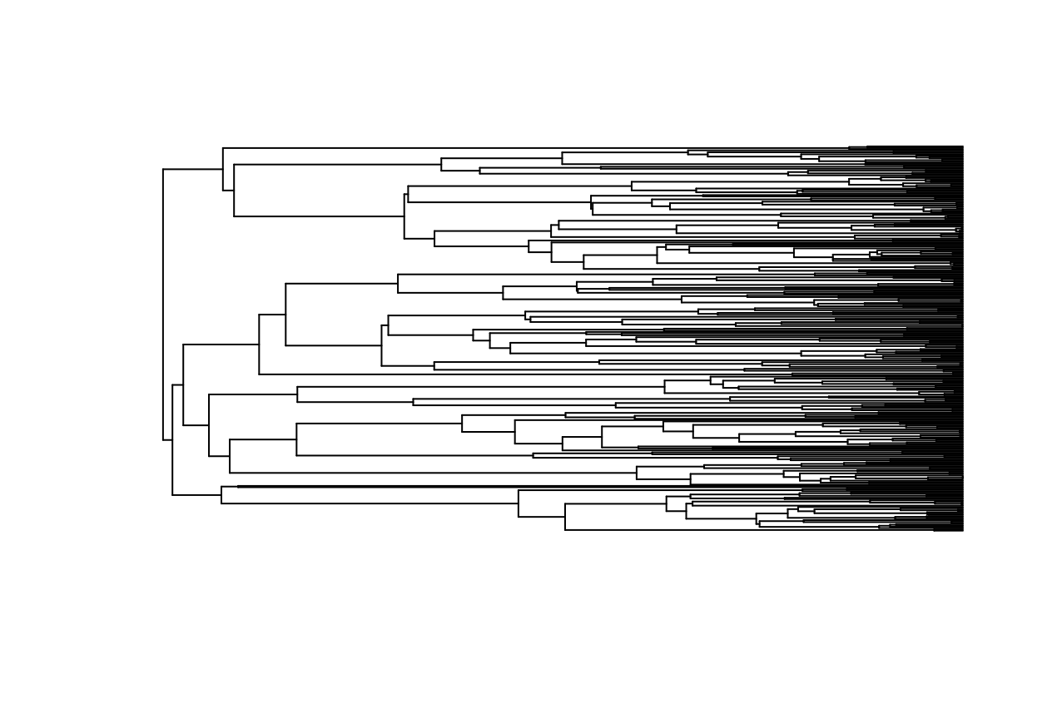
Yule model: pure birth
Age=10
Birth rate = 0.3
Death rate = 0.0
Age=10
Birth rate = 0.5
Death rate = 0.0

Slide 17
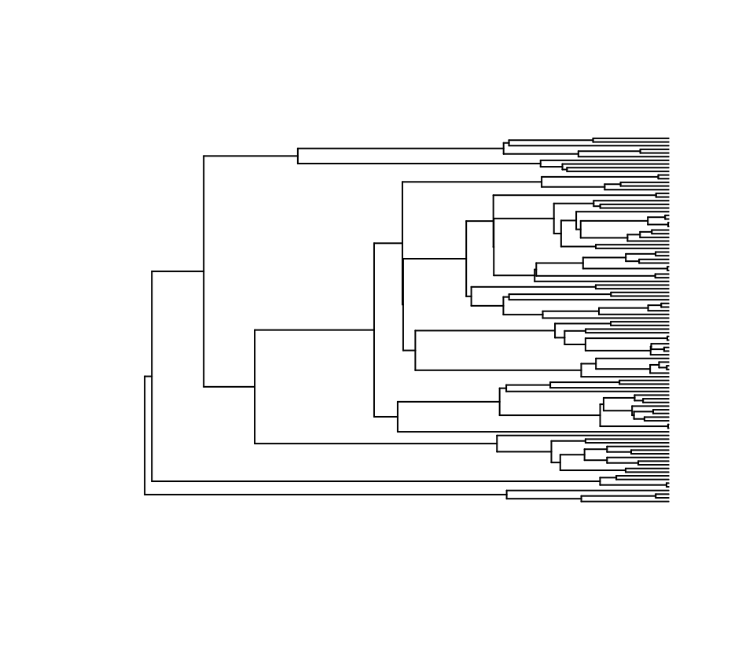
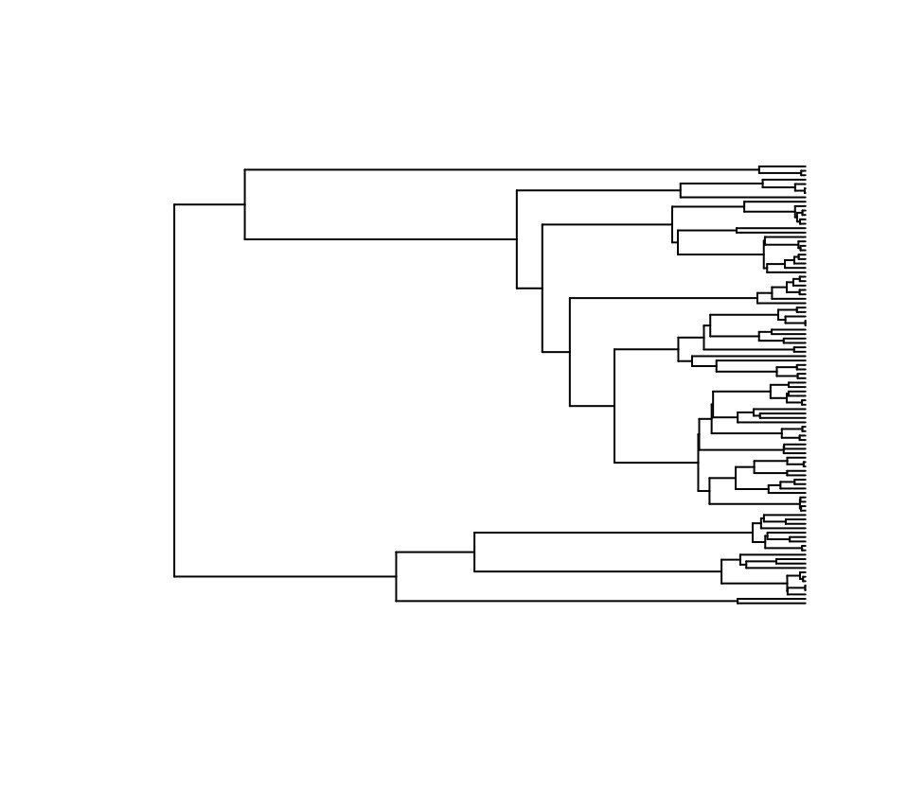
Birth-death model
100 taxa
Birth rate = 0.3
Death rate = 0.0
100 taxa
Birth rate = 3.0
Death rate = 2.9

Slide 18
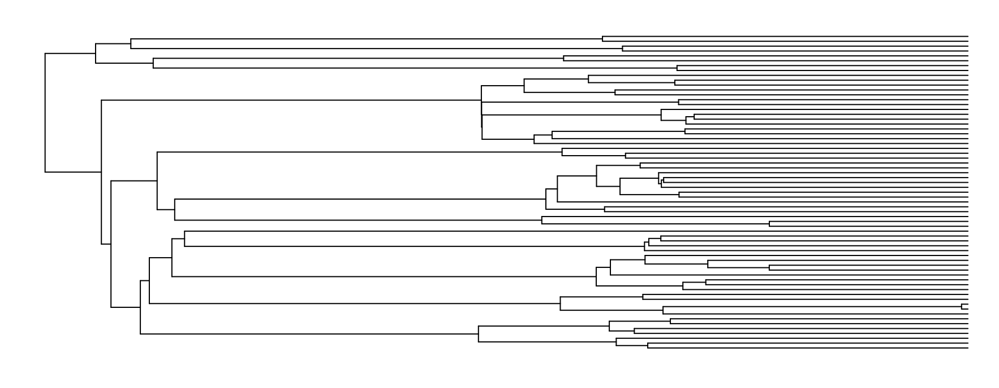
Birth-death skyline model
Birth rate = 0.3
Birth rate = 0.01
Birth rate = 0.4
Birth rate = 0.01

Slide 19
Rates model: the “linguistic clock”
Strict clock: all branches have a single rate
Relaxed clock: branch rates are different

Slide 20
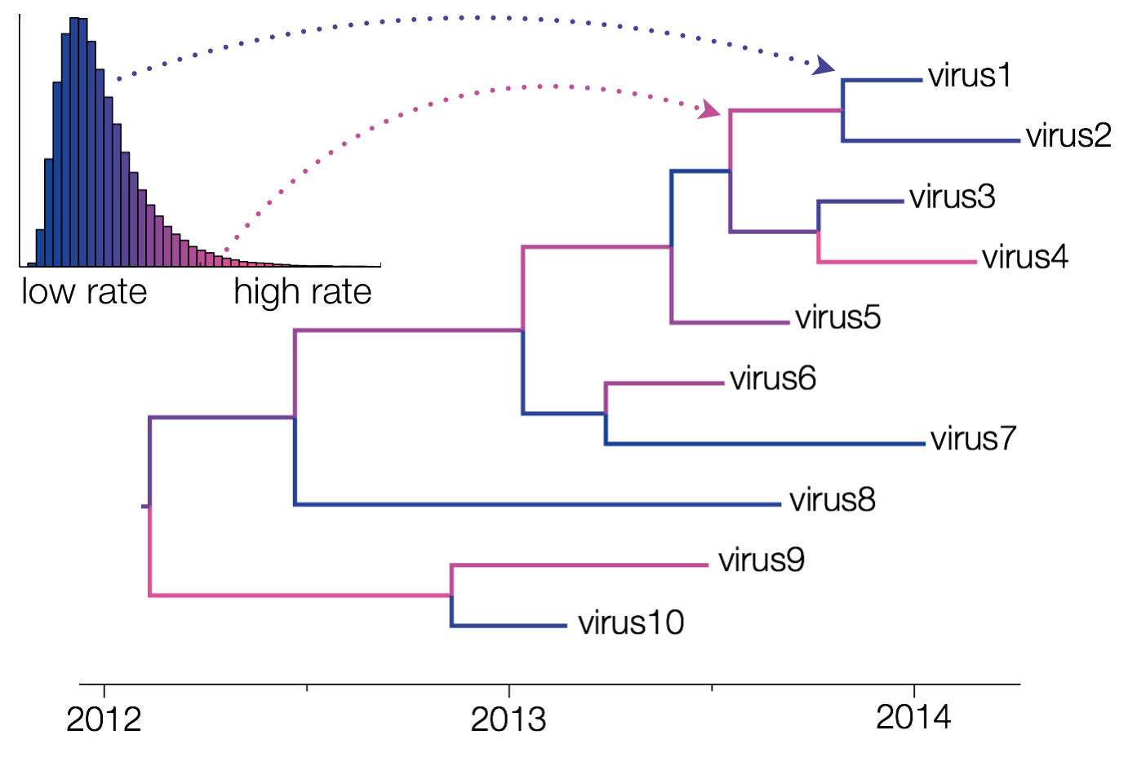

Slide 21
Clock model summary
2 model parameters:
Clock rate mean
Average rate of change across all branches of the tree
Clock rate standard devation
How much variation between branches of the tree

Slide 22
Part 3: the substitution model
Jukes-Cantor model
Kimura-80 model
General Time-Reversible model
A
T
A
β
T
A
β
T
α
γ
δ
β
α
α
ε
G
C
G
C
G
η
C
β

Slide 23
For linguistic models we have 2 states: absent (0) and present (1)
0
1
Rate of gain of a cognate and rate of loss of a cognate is determined by the stable frequency parameters

Slide 24


Stable frequencies are driven by rates
Chance of moving to town in the next year = 2.5%
Chance of moving to city in the next year = 10%
Population = 40000
Population = 10000
1000 people move
1000 people move

Slide 25
Chance of moving to town in the next year = 2.5%
Chance of moving to city in the next year = 10%
Population = 25000
Population = 25000
2500 people move
625 people move

Slide 26
Stable frequencies of the present and absent states
Absent relative frequency 0.9
Few gains
0
1
Present relative frequency 0.1
Many losses

Slide 27
The binary covarion model
0
1
ON state
Fast transitions
Switching between on and off states
0
1
OFF state
Slow transitions

Slide 28
Substitution model summary
3 model parameters:
Stable frequencies of present and absent states
Determines how common gains and losses of a cognate are
Switch rate between the on and off states
Relative rate of the on and off states (covarion alpha parameter)

Slide 29
Overview of a generative phylogenetic model
Switch rate
Birth rate
Covarion alpha
Tree model
Death rate
frequencies
Tree
Change times
0
Model of cognate gain and loss
1
Clock rate
“clock” model
Branches have different rates
data
Clock standard deviation

Slide 30
Phylogenetic inference
A phylogenetic generative model describes how we go from the model to generating data
We hope that this generative model is a good approximation of the real process that produced the real data
In phylogenetic inference we must work backwards to estimate the model parameters from the data

Slide 31
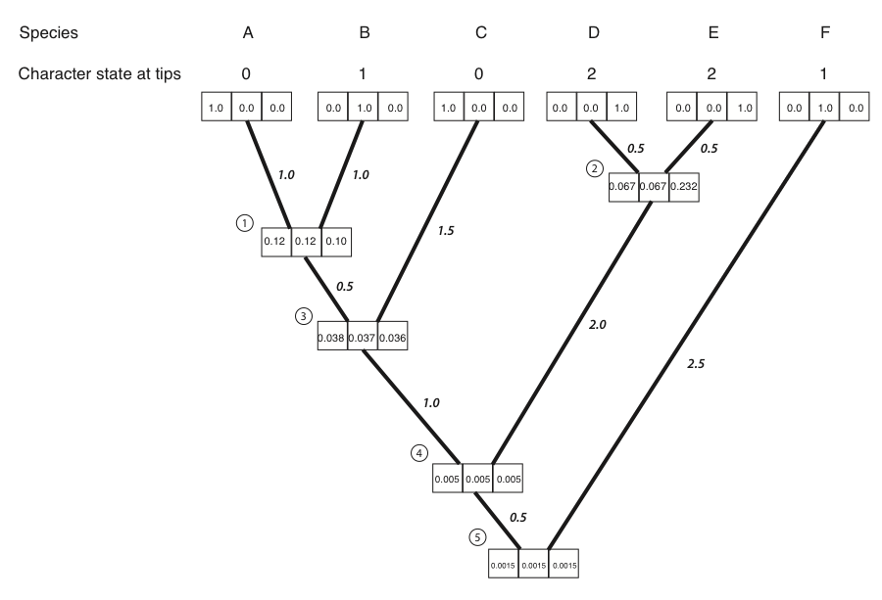
Step 1: probability of the data (the likelihood)
Felsenstein’s pruning algorithm
Given a tree, branch rates and a substitution model, we can calculate the probability of observing the data

Slide 32
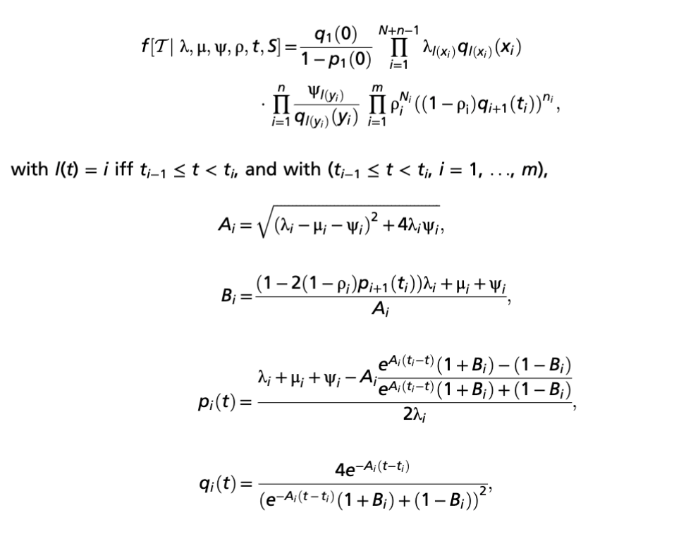
Step 2: probability of the tree
100 taxa
Birth rate = 3.0
Death rate = 2.9
It’s complicated…

Slide 33
Step 3: prior probabilities for model parameters
Tree model
Birth rate
Covarion alpha
Death rate
Switch rate
frequencies
Tree
Change times
Model of cognate gain and loss
Clock rate
“clock” model
Branches have different rates
data
Clock standard deviation

Slide 34
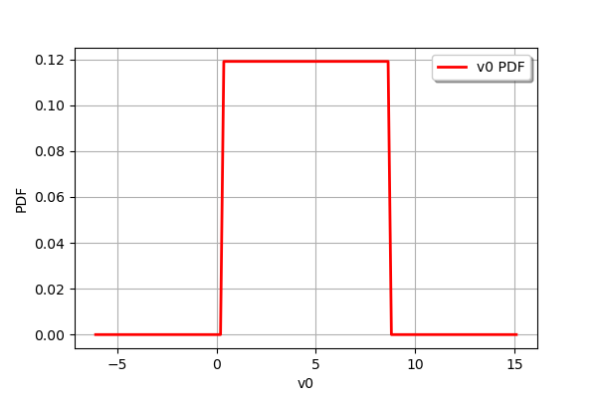
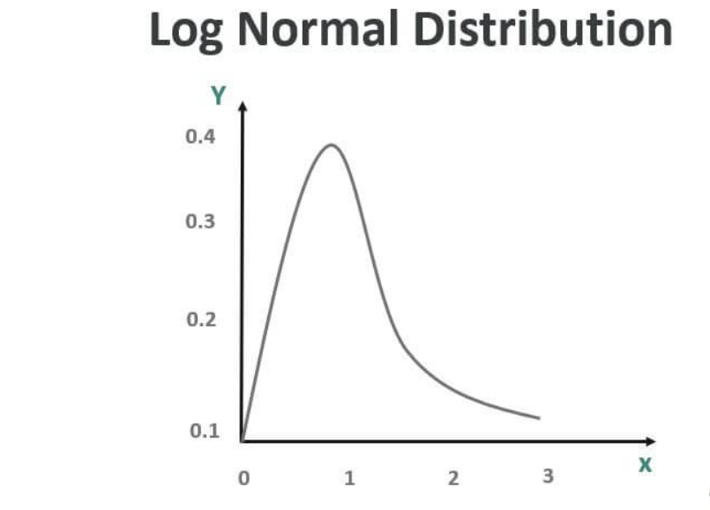
Prior probabilities
Describe knowledge about what sensible parameter values are
This knowledge should not come from looking at the data
Often we have no other knowledge, and use uninformative priors (high standard deviation on a normal or lognormal distribution), or a uniform distribution
Uniform distribution

Slide 35
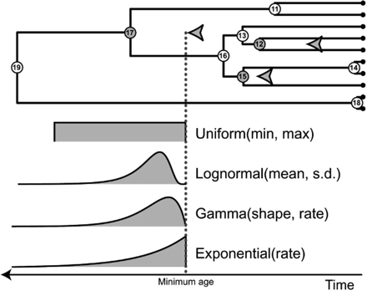
The clock model can be calibrated using a Node age prior
Node calibrations are set as prior probability distributions on node age in a Bayesian analysis.
These are usually in the form a probability distribution, with a lower bound set at the age of the calibration fossil

Slide 36
Node calibration example: Pacific islands
Radiocarbon dates for Northern Melanesia, Western Polynesia and Eastern Polynesia

Slide 37
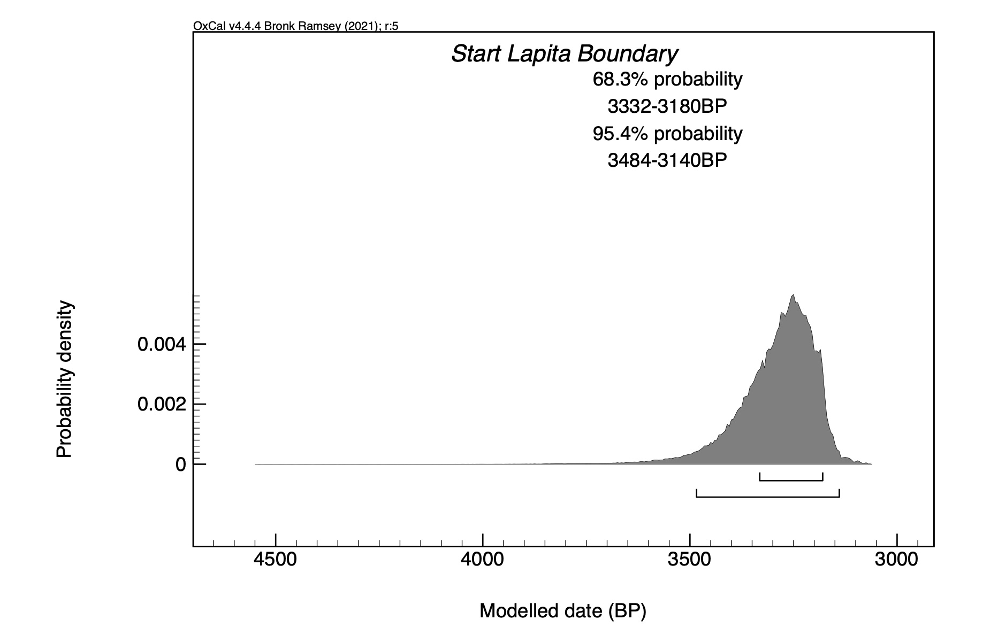
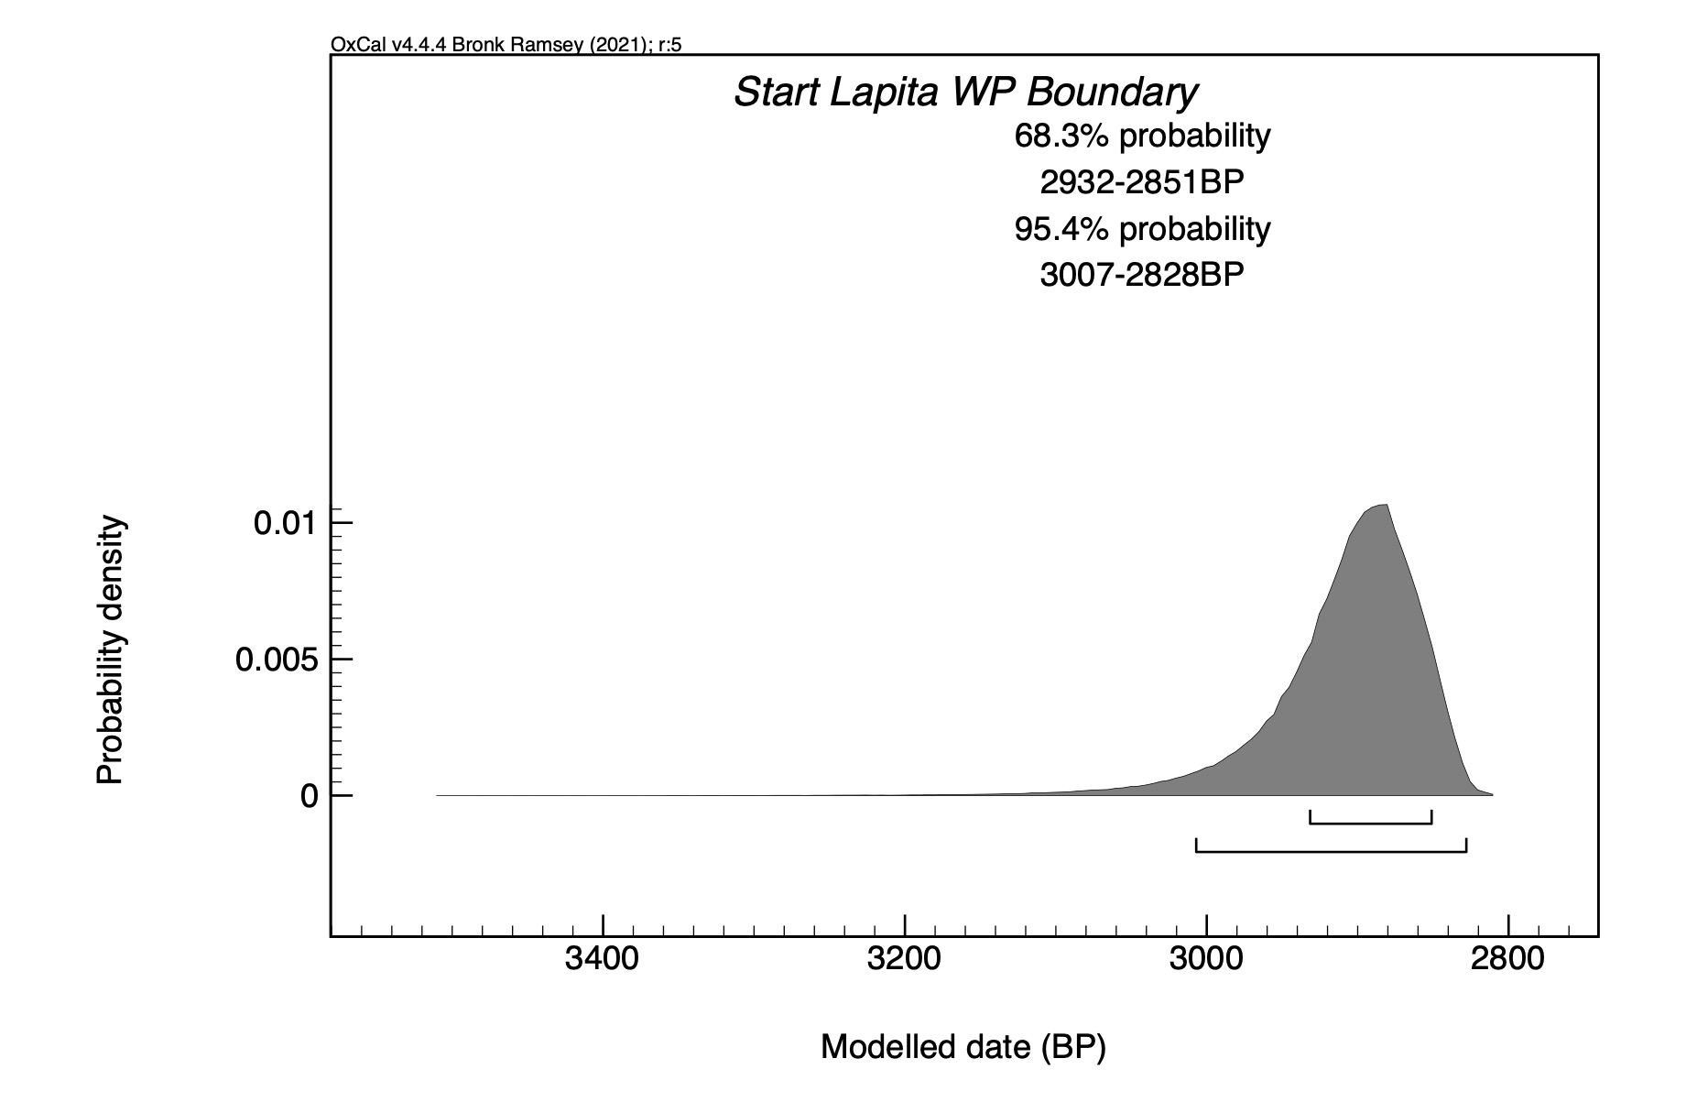
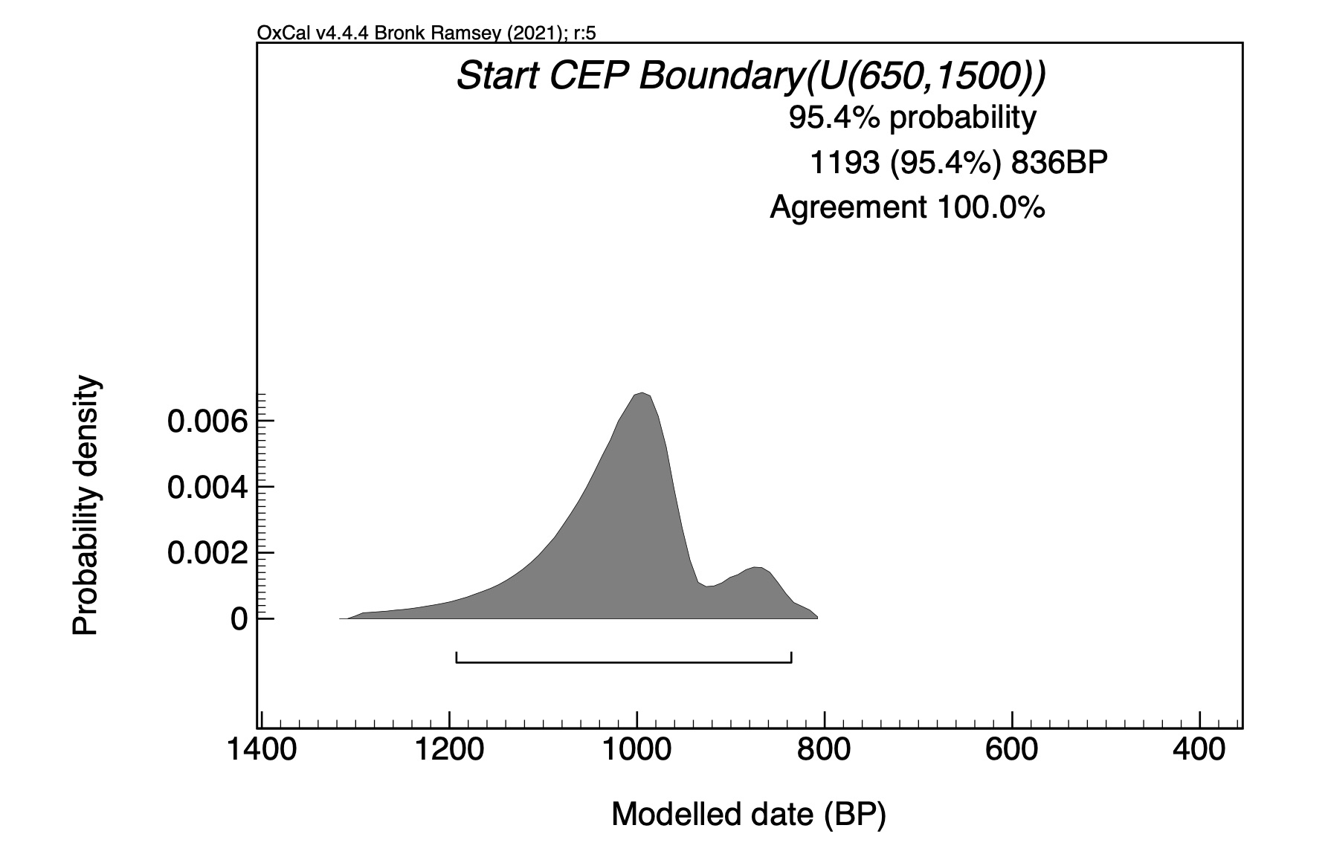
Radiocarbon dates
Approximate first arrival in Melanesia, Polynesia and Eastern Polynesia
If we assume this marks the beginning of independent language evolution, this information can be used for node calibration

Slide 38
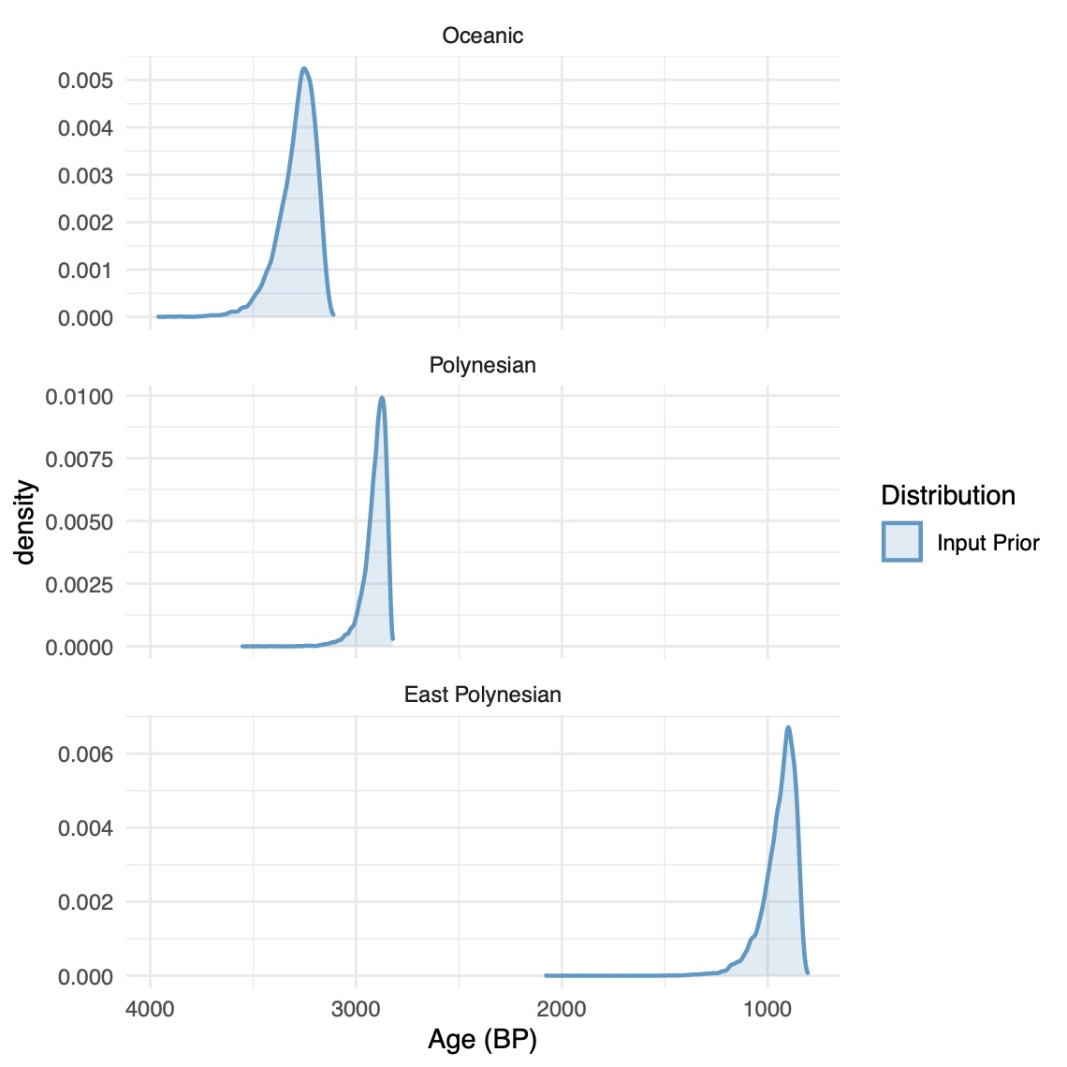
Implementing node age calibrations
1
2
2
3
3
1

Slide 39
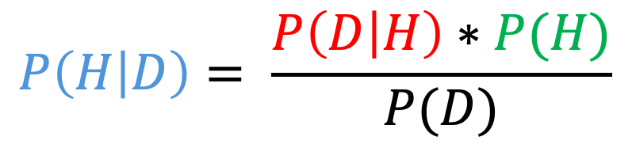
Putting it all together: Bayes theorum
1. Likelihood: probability of the data given the tree and parameter values
3. Prior probabilities of model parameters
2. Probability of the tree
likelihood
prior
Posterior probability
$$P\left(H | D\right)= \frac{P\left(D | H\right)∗P(H)}{P(D)}$$
Model evidence

Slide 40
Markov Chain Monte Carlo
Sample every XXX generations
Stored parameter values
Stored tree
Discard proposed tree and parameter values
Replace stored parameters and tree
Propose new values and/or tree
reject
accept
Calculate posterior probability
Posterior probability higher?
Posterior probability lower?

Slide 41
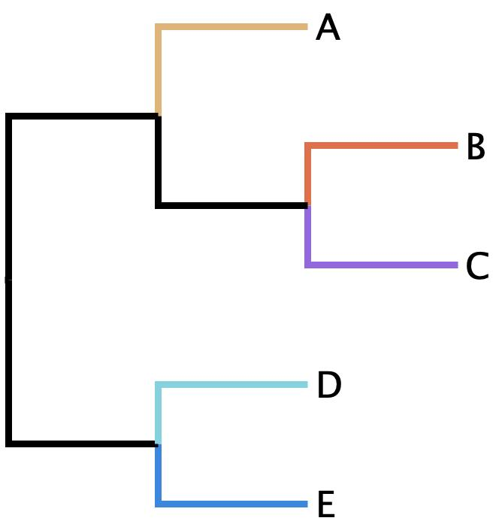
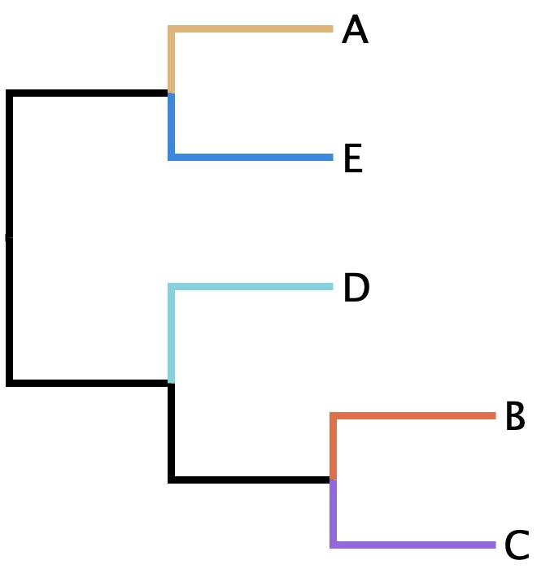
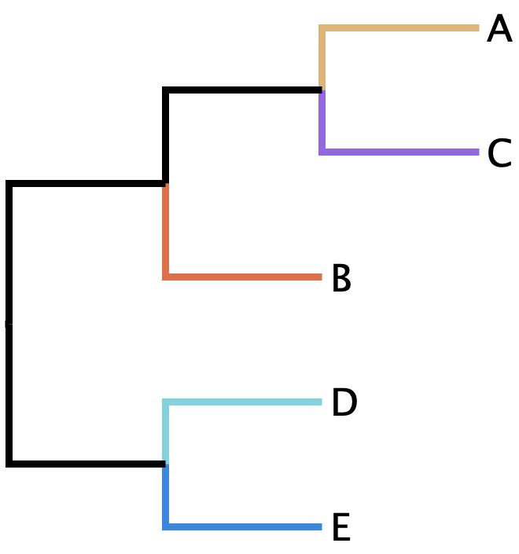
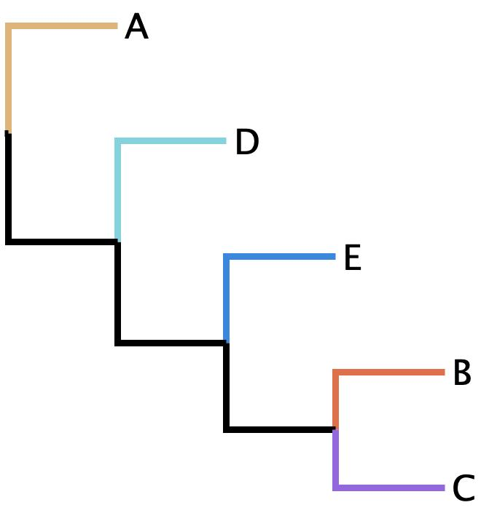
Operators
Exchange operator
Subtree slide operator
Wilson-Balding operator

Slide 42
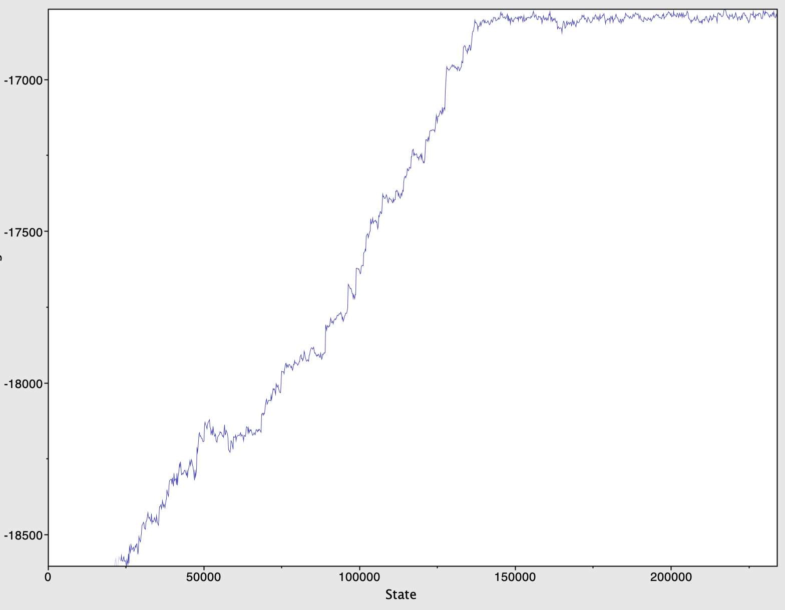
Stationary
Burn-in

Slide 43
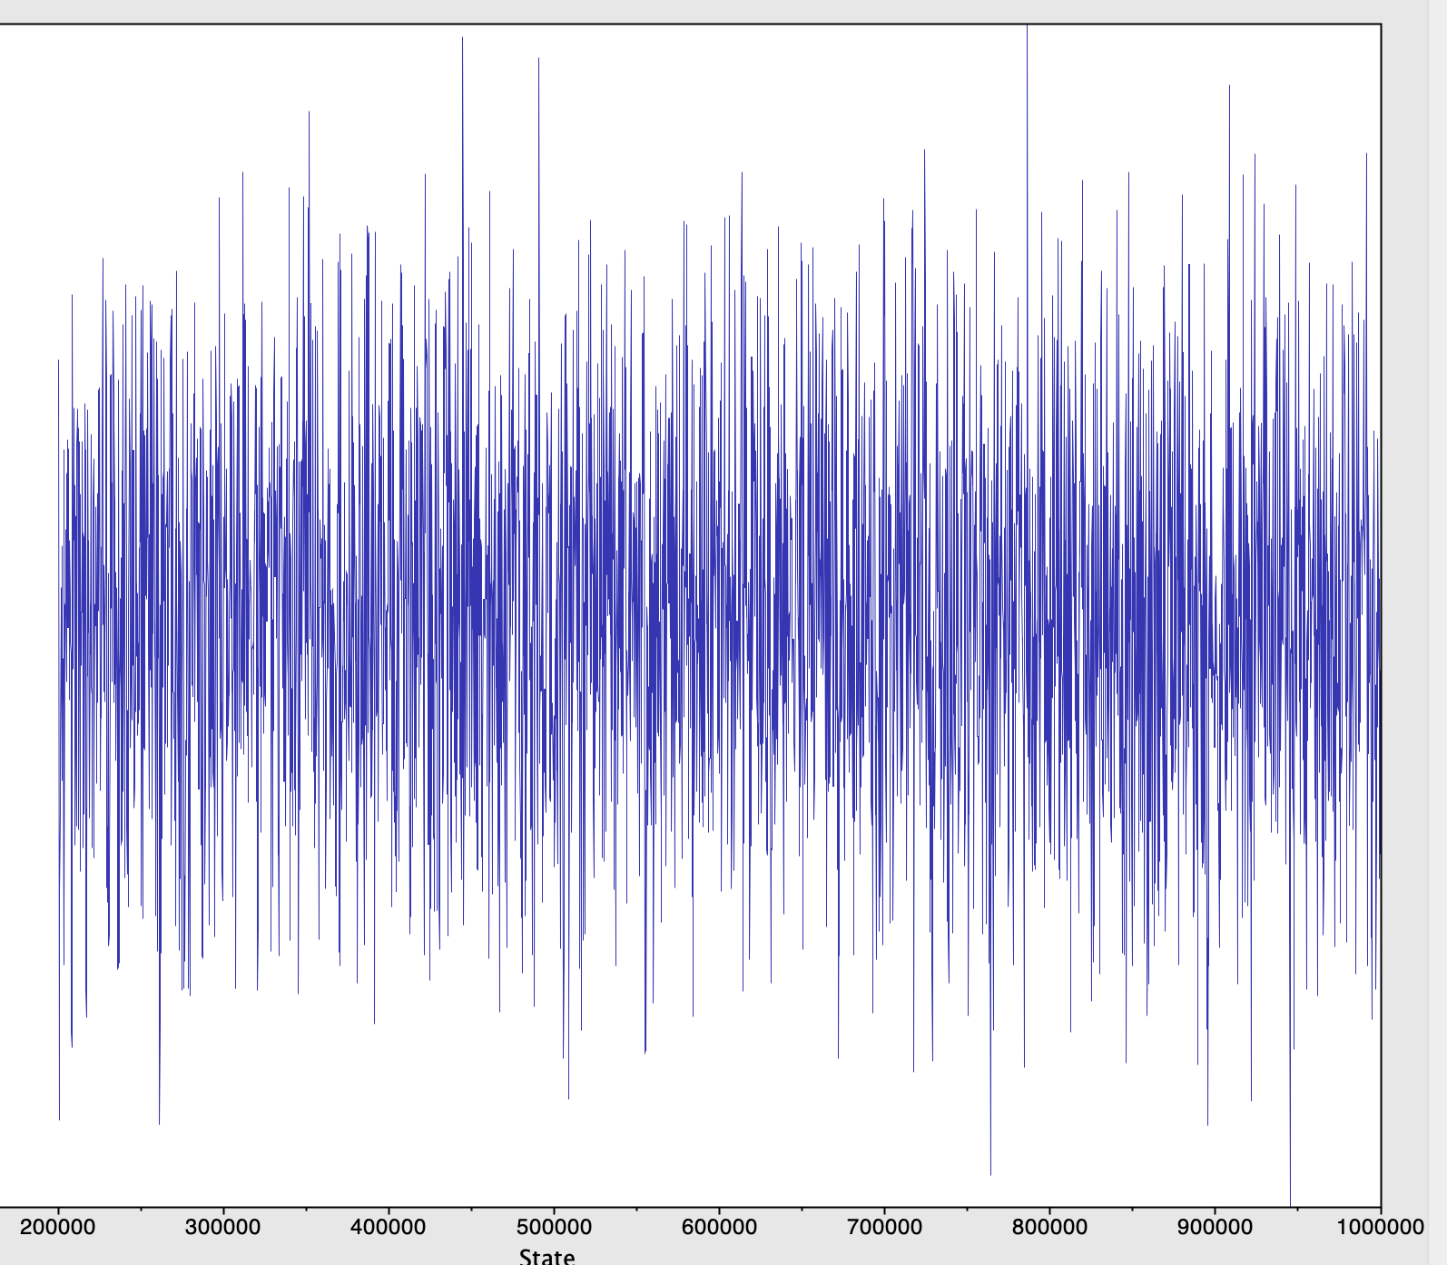
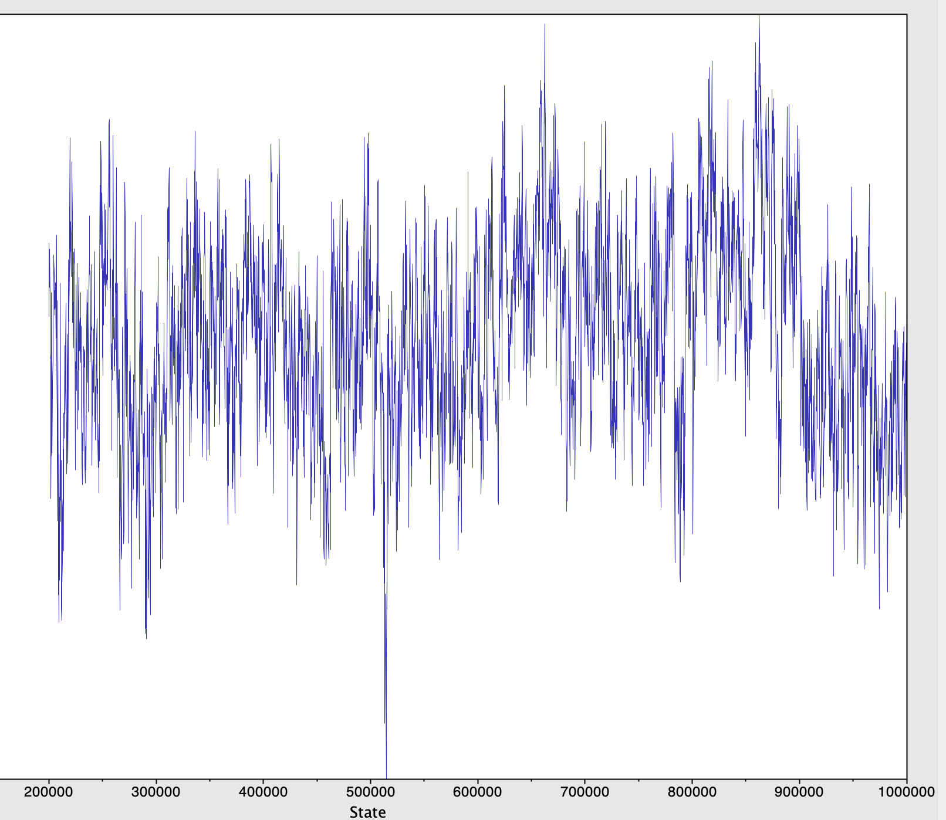
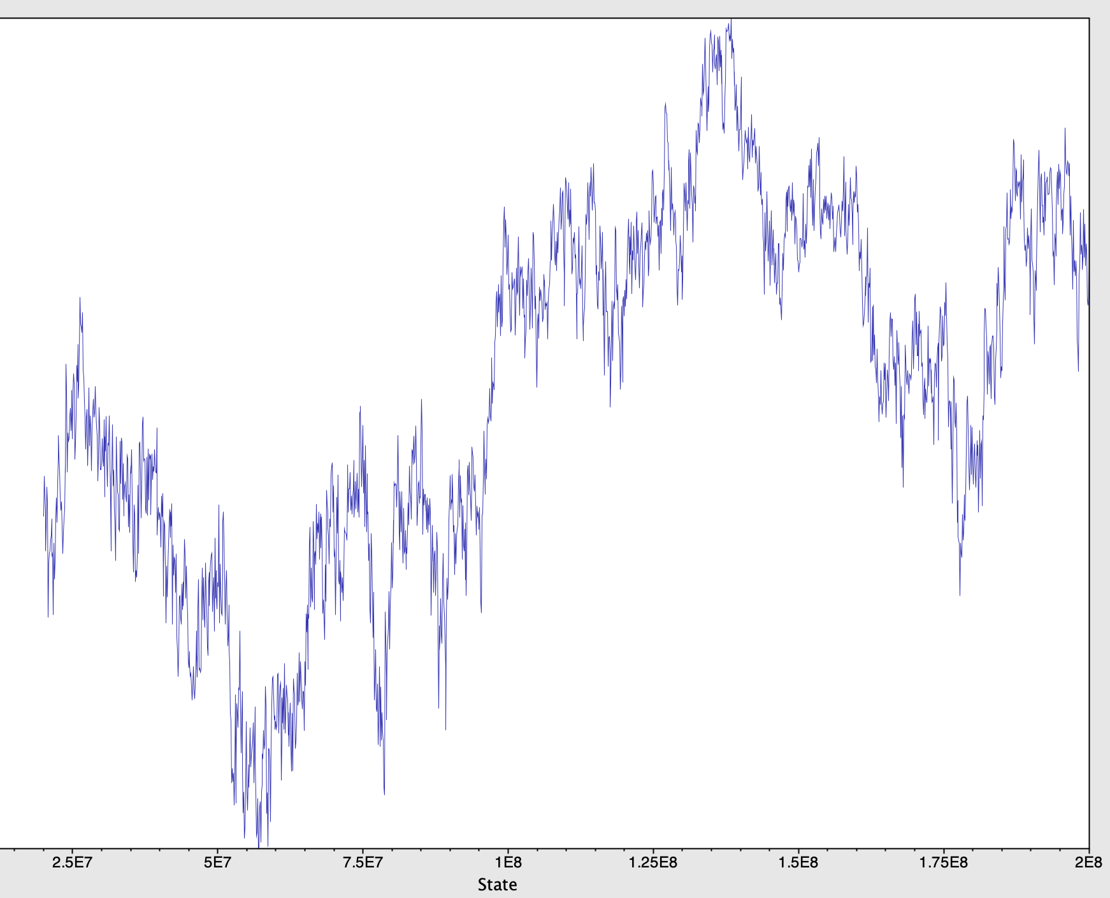
Good and bad chains
😀
😕
😱

Slide 44
The end result is a sample
Sample | posterior | likelihood | prior | Tree model | birth rate | covarion alpha | covarion switch | frequency absent | frequency present | clock mean | clock standard dev
10000 | -16826.3 | -16430.0 | -396.4 | -339.8 | 9.86E-04 | 0.0394 | 0.4450 | 0.9535 | 0.0465 | 5.14E-05 | 0.4874
20000 | -16820.6 | -16435.6 | -385.0 | -318.4 | 1.50E-03 | 0.0155 | 0.4249 | 0.9502 | 0.0498 | 9.48E-05 | 0.5483
30000 | -16841.3 | -16429.1 | -412.2 | -336.1 | 1.02E-03 | 0.0310 | 0.5375 | 0.9528 | 0.0472 | 6.18E-05 | 0.7948
40000 | -16827.4 | -16441.0 | -386.4 | -336.6 | 9.03E-04 | 0.0232 | 0.4400 | 0.9526 | 0.0474 | 6.30E-05 | 0.5497
50000 | -16821.1 | -16430.1 | -391.0 | -341.7 | 8.66E-04 | 0.0590 | 0.3955 | 0.9526 | 0.0474 | 5.43E-05 | 0.4969
60000 | -16839.0 | -16447.7 | -391.4 | -330.5 | 1.26E-03 | 0.0651 | 0.3525 | 0.9552 | 0.0448 | 6.40E-05 | 0.5866
70000 | -16813.5 | -16434.5 | -378.9 | -327.5 | 9.98E-04 | 0.0562 | 0.3988 | 0.9540 | 0.0460 | 7.90E-05 | 0.5809
80000 | -16810.5 | -16426.9 | -383.6 | -328.2 | 1.18E-03 | 0.0562 | 0.4185 | 0.9541 | 0.0459 | 7.25E-05 | 0.5421
90000 | -16843.1 | -16443.6 | -399.5 | -341.8 | 8.29E-04 | 0.0562 | 0.4501 | 0.9541 | 0.0459 | 5.31E-05 | 0.7221
100000 | -16822.7 | -16430.8 | -391.9 | -346.0 | 8.70E-04 | 0.0313 | 0.3919 | 0.9541 | 0.0459 | 4.37E-05 | 0.4759

Slide 45
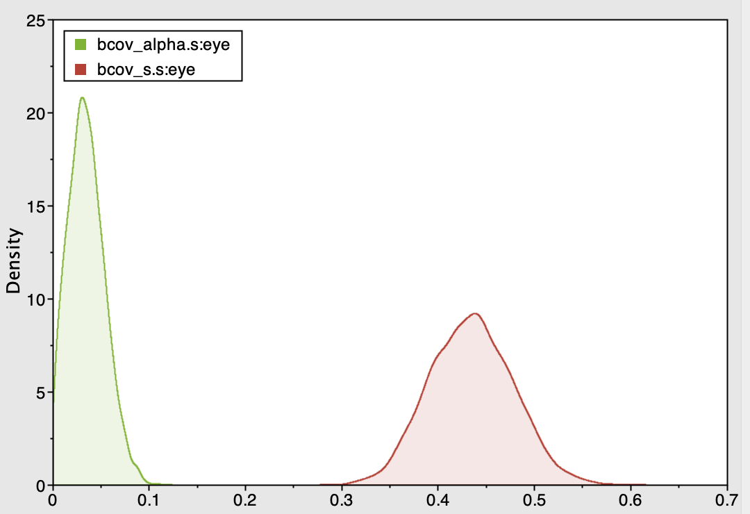
Summarising output - parameters

Slide 46
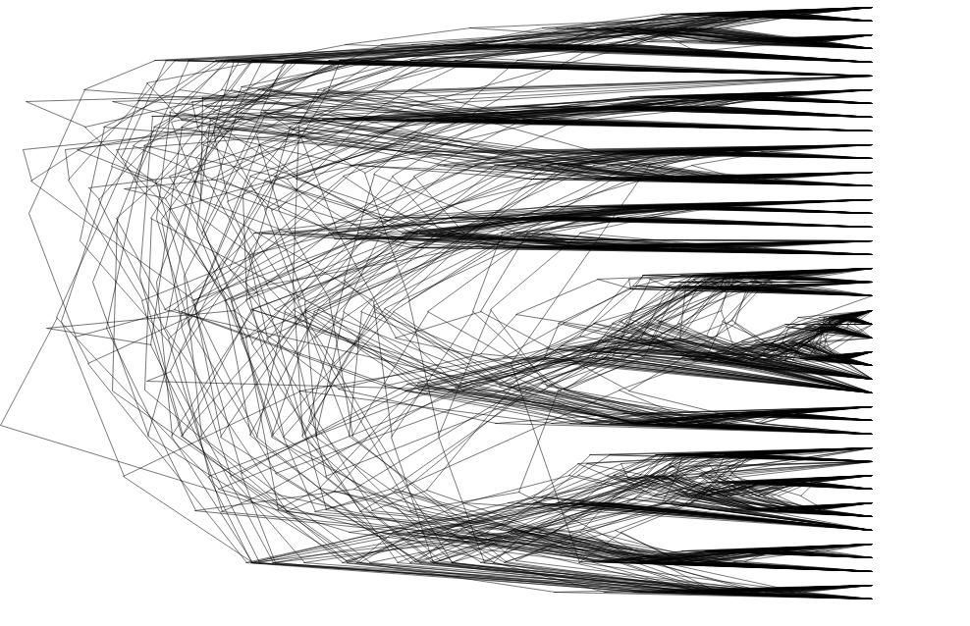
Tree samples

Slide 47
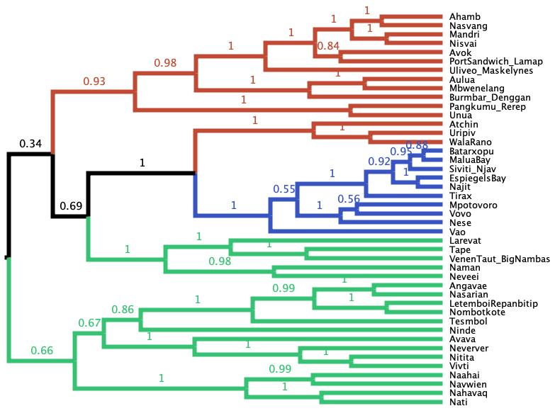
Summarising output – consensus trees

Slide 48
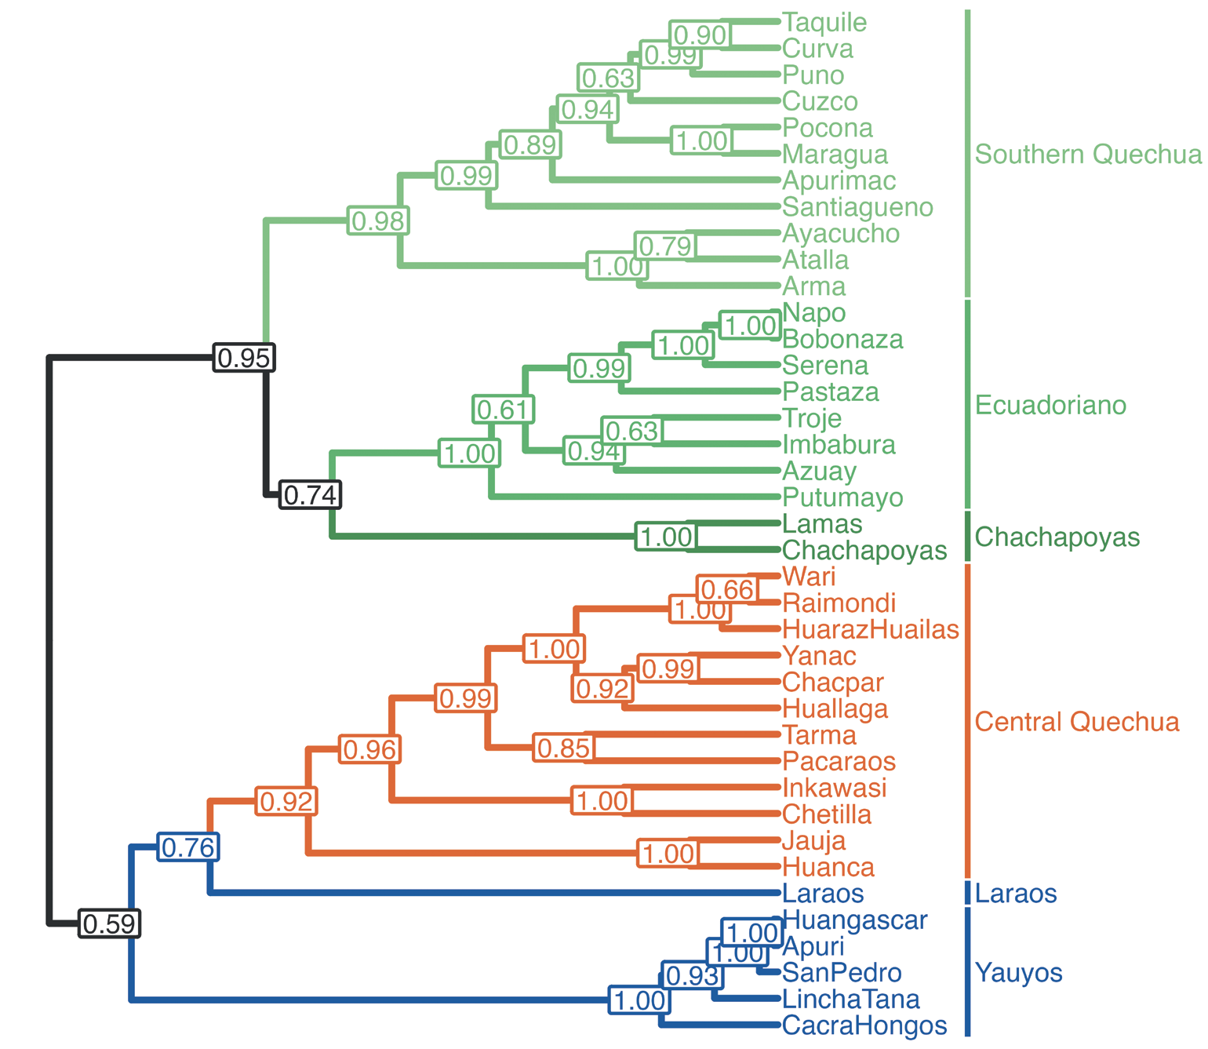
Morning tutorial: Phylogenetic analysis of the Quechua Language Family
Blum et al. (2023) A Phylolinguistic Classification of
the Quechua Language Family

Slide 49

Model
Analysis
3. Prior probabilities of model parameters
1. Likelihood: probability of the data given the tree and parameter values
Death rate
2. Probability of the tree
Birth rate
Change times
likelihood
prior
Posterior probability
$$P\left(H | D\right)= \frac{P\left(D | H\right)∗P(H)}{P(D)}$$
Tree model
Model evidence
Covarion alpha
Switch rate
Markov Chain Monte Carlo
Operators
frequencies
Tree
Site Model
Clock rate
data
Clock model
Clock standard deviation
Sample of trees and parameter values

Slide 50





Workflow
CLDF
Trace file
(.log)
Data
.nex file
BEAUti
Analysis file
(.xml)
BEAST2
Tree file
(.trees)
Figtree/
Icytree
Summary tree
(.tree)
TreeAnnotator
Figure
(.pdf)

